Slide 1
SWAN (K18X001.00) Cross section Test Explain
Prepare: JBD-VN-ME
Date: 2022.Sep-05

Slide 2
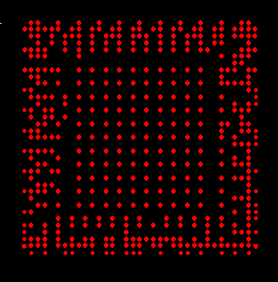

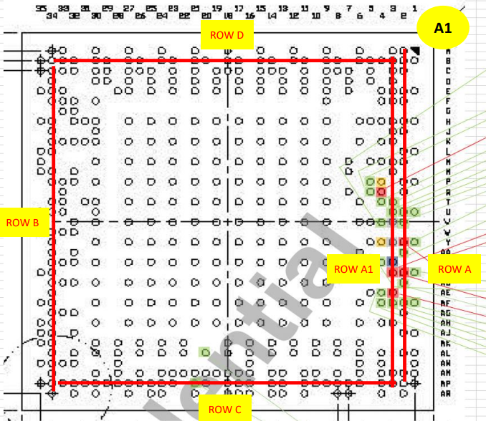
SWAN (K18X001.00) Cross Section
1.1. Where is point start #1 ? :
Definition rule will be as below:
ROW 2
ROW 1
Row 1
1#
22#
U1
ROW 3
ROW 4
ROW 1
ROW 2
ROW 3
U1313
1.2. Why chose the section Row 1, 2, 3 :
Together with PE & PQE department to discuss the choice of U1 & U1313 cutting position.
1.3 If proceed Next section test, please analysis below in order :
Next build, the experiment can be based on the customer's request to select the cutting position.
The positions of Row B, C, D can be done on request, but with positions A and A1 because
they are too close distance, so only 1 position cutting can be made.
→Suggest customers choose another row cutting of position.

Slide 3
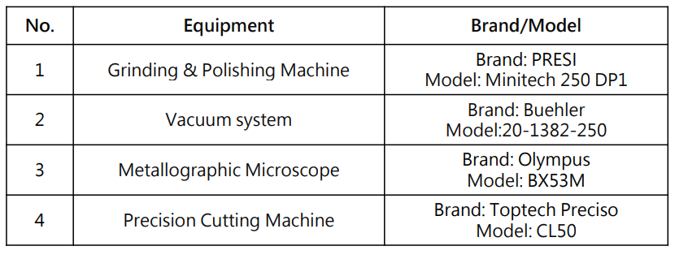
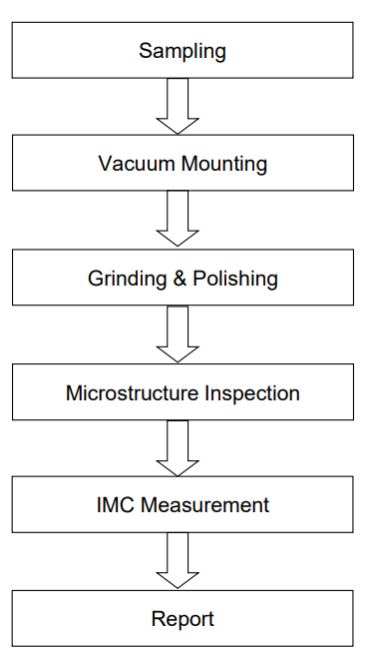
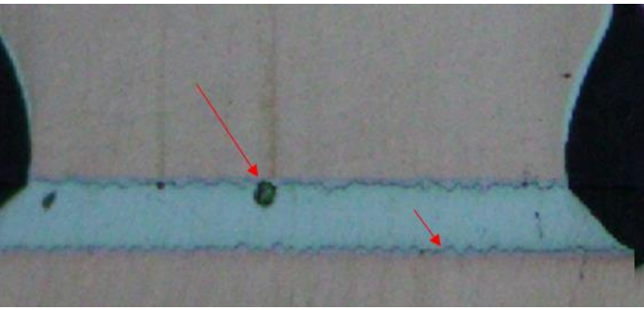
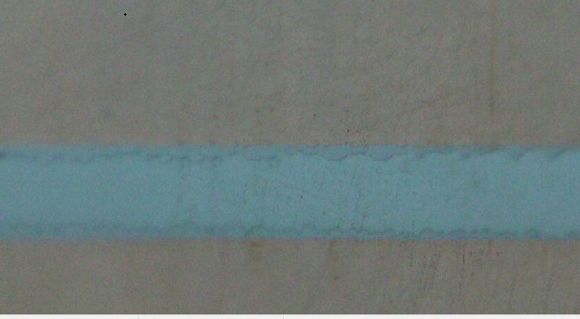
SWAN (K18X001.00) Cross Section
2.1. Please polish more with finer sandpaper:
Microstructure Inspection:
Test Equipment:
50X
100X
200X
500X
It is difficult to distinguish between the IMC layer and the
solder layer because the image is not clear.
Normal inspection of process:
After cutting, staff will use microscope levels to inspect the PAD positions with values
of 100 X or 200 X depending on the size of the PAD
If there is no abnormality, the PAD positions will be randomly selected to take 500X
and measure the IMC value.
If there is an abnormality, we will use 500X magnification to check that PAD position and
measure then calculate the Crack % value of the PAD pin.
Experimental Flow test:
Solder Void
Traces of
Grinding & Polishing
Magnify 200X
Magnify 500X

Slide 4
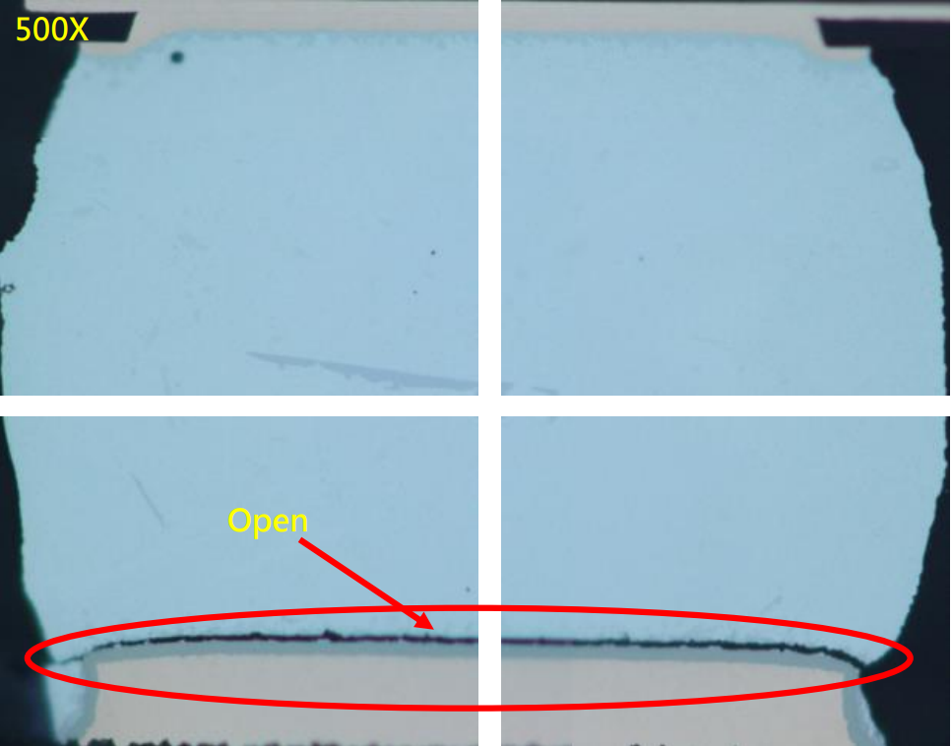
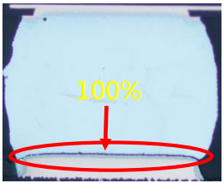
SWAN (K18X001.00) Cross Section
Crack image of Sample:
200X

Slide 5

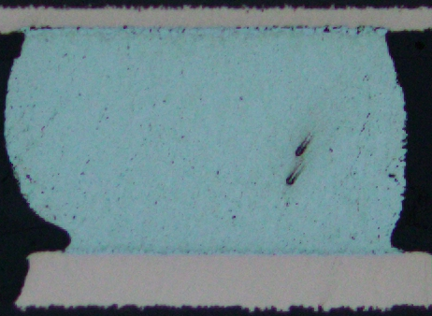
SWAN (K18X001.00) Cross Section
2.2. BGA U1 review (Red point):
After cutting and inspecting with 200X magnification, 100% of all there are no abnormalities, so use only 200X magnification,
do not use 500X for all normal locations as below:
Row-1
3#
5#

Slide 6
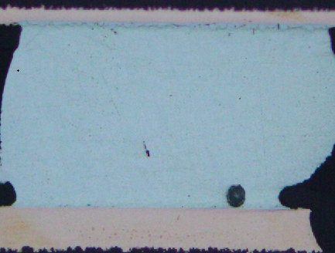

SWAN (K18X001.00) Cross Section
2.2. BGA U1 review (Red point):
After cutting and inspecting with 200X magnification, 100% of all there are no abnormalities, so use only 200X magnification,
do not use 500X for all normal locations as below:
Row-2
Row-3
9#
7#

Slide 7
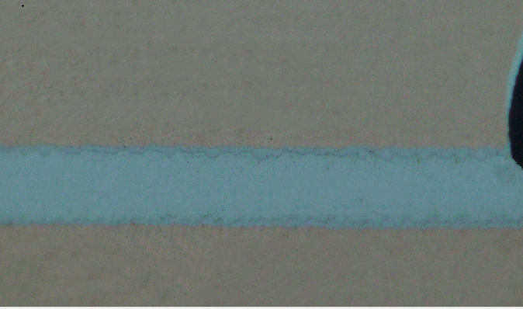
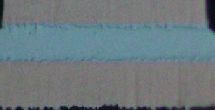
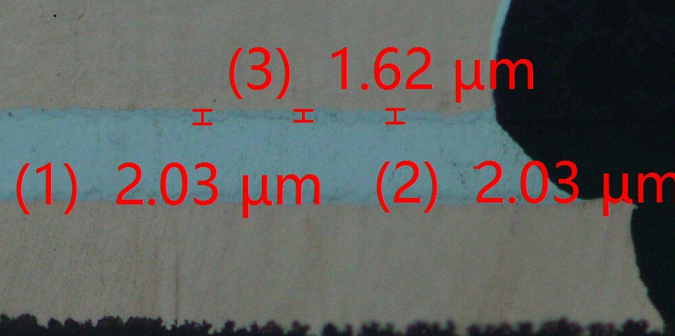
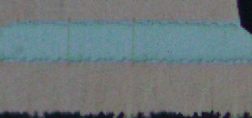
SWAN (K18X001.00) Cross Section
2.3. QFN U1313 review:
Magnify*200x
Magnify*500x
Magnify*200x
IMC layer

Slide 8
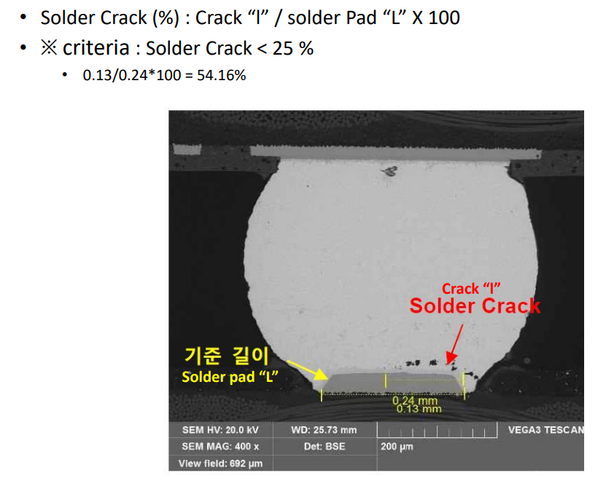
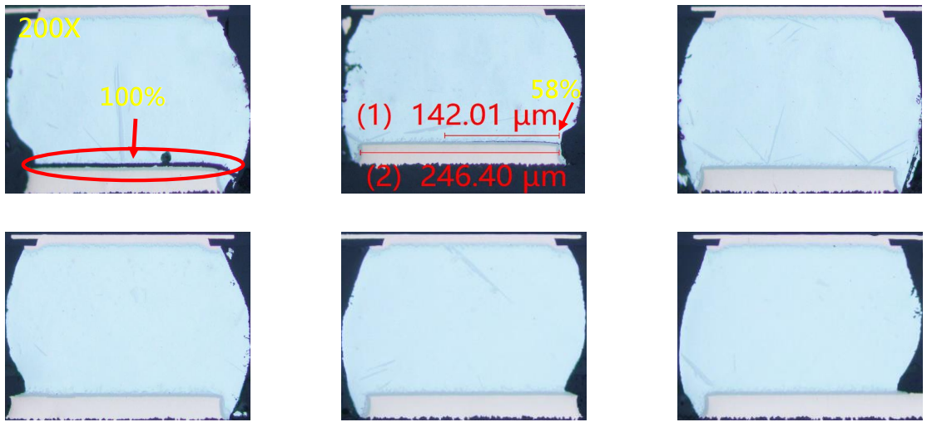
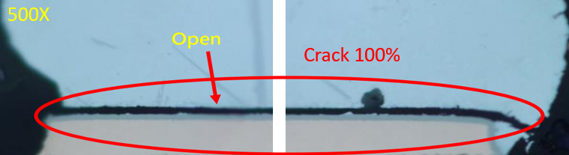
SWAN (K18X001.00) Cross Section
2.2. Define the Solder crack:
If checking and detecting solder crack, Fii side defines and evaluate the same method as the customer's method.

Slide 9
Thank you.

